Slide 1
RUSTikales Rust for beginners
©Philippe Felix Haupt 2023

Slide 2
Plan for today
©Philippe Felix Haupt 2023

Slide 3
Plan for today
Recap
©Philippe Felix Haupt 2023

Slide 4
Plan for today
Recap
Loops in Rust
©Philippe Felix Haupt 2023

Slide 5
Plan for today
Recap
Loops in Rust
loop
©Philippe Felix Haupt 2023

Slide 6
Plan for today
Recap
Loops in Rust
loop
while
©Philippe Felix Haupt 2023

Slide 7
Plan for today
Recap
Loops in Rust
loop
while
for
©Philippe Felix Haupt 2023

Slide 8
Recap
©Philippe Felix Haupt 2023

Slide 9
Recap
Integers in Rust: i8, u8, i16, u16, …, i128, u128
©Philippe Felix Haupt 2023

Slide 10
Recap
Integers in Rust: i8, u8, i16, u16, …, i128, u128
`let` to declare an immutable variable
©Philippe Felix Haupt 2023

Slide 11
Recap
Integers in Rust: i8, u8, i16, u16, …, i128, u128
`let` to declare an immutable variable
`let mut` to declare a mutable variable
©Philippe Felix Haupt 2023

Slide 12
Recap
Integers in Rust: i8, u8, i16, u16, …, i128, u128
`let` to declare an immutable variable
`let mut` to declare a mutable variable
`let var: [type; size] = …;` to declare an array with the given type and size
©Philippe Felix Haupt 2023

Slide 13
Recap
Integers in Rust: i8, u8, i16, u16, …, i128, u128
`let` to declare an immutable variable
`let mut` to declare a mutable variable
`let var: [type; size] = …;` to declare an array with the given type and size
`let var: Vec<type> = …;` to declare a vector with the given type
©Philippe Felix Haupt 2023

Slide 14
Recap
Integers in Rust: i8, u8, i16, u16, …, i128, u128
`let` to declare an immutable variable
`let mut` to declare a mutable variable
`let var: [type; size] = …;` to declare an array with the given type and size
`let var: Vec<type> = …;` to declare a vector with the given type
Elements in Arrays and Vectors always have the same type
©Philippe Felix Haupt 2023

Slide 15
Recap
Integers in Rust: i8, u8, i16, u16, …, i128, u128
`let` to declare an immutable variable
`let mut` to declare a mutable variable
`let var: [type; size] = …;` to declare an array with the given type and size
`let var: Vec<type> = …;` to declare a vector with the given type
Elements in Arrays and Vectors always have the same type
Arrays have a fixed size, Vectors are resizable
©Philippe Felix Haupt 2023

Slide 16
Recap
Integers in Rust: i8, u8, i16, u16, …, i128, u128
`let` to declare an immutable variable
`let mut` to declare a mutable variable
`let var: [type; size] = …;` to declare an array with the given type and size
`let var: Vec<type> = …;` to declare a vector with the given type
Elements in Arrays and Vectors always have the same type
Arrays have a fixed size, Vectors are resizable
`var[index]` to access the element at a given index
©Philippe Felix Haupt 2023

Slide 17
Recap
Integers in Rust: i8, u8, i16, u16, …, i128, u128
`let` to declare an immutable variable
`let mut` to declare a mutable variable
`let var: [type; size] = …;` to declare an array with the given type and size
`let var: Vec<type> = …;` to declare a vector with the given type
Elements in Arrays and Vectors always have the same type
Arrays have a fixed size, Vectors are resizable
`var[index]` to access the element at a given index
`var[0] = 5;` sets the element at index 0 to 5
`let x = var[1];` gets the element at index 1 and stores it in `x`
©Philippe Felix Haupt 2023

Slide 18
Recap
Integers in Rust: i8, u8, i16, u16, …, i128, u128
`let` to declare an immutable variable
`let mut` to declare a mutable variable
`let var: [type; size] = …;` to declare an array with the given type and size
`let var: Vec<type> = …;` to declare a vector with the given type
Elements in Arrays and Vectors always have the same type
Arrays have a fixed size, Vectors are resizable
`var[index]` to access the element at a given index
`var[0] = 5;` sets the element at index 0 to 5
`let x = var[1];` gets the element at index 1 and stores it in `x`
Arrays and Vectors are zero-indexed
For size `N`, indices 0 to N-1 are defined, Rest results in Out Of Bounds Errors
©Philippe Felix Haupt 2023

Slide 19
Recap
Integers in Rust: i8, u8, i16, u16, …, i128, u128
`let` to declare an immutable variable
`let mut` to declare a mutable variable
`let var: [type; size] = …;` to declare an array with the given type and size
`let var: Vec<type> = …;` to declare a vector with the given type
Elements in Arrays and Vectors always have the same type
Arrays have a fixed size, Vectors are resizable
`var[index]` to access the element at a given index
`var[0] = 5;` sets the element at index 0 to 5
`let x = var[1];` gets the element at index 1 and stores it in `x`
Arrays and Vectors are zero-indexed
For size `N`, indices 0 to N-1 are defined, Rest results in Out Of Bounds Errors
vec! as convenience macro for creating Vectors
©Philippe Felix Haupt 2023

Slide 20
Recap
Exercises:
Did you look at them?
Did you understand them?
Were you able to solve them?
©Philippe Felix Haupt 2023

Slide 21
Recap
Exercises:
Did you look at them?
Did you understand them?
Were you able to solve them?
Important to know:
©Philippe Felix Haupt 2023

Slide 22
Recap
Exercises:
Did you look at them?
Did you understand them?
Were you able to solve them?
Important to know:
Many helper methods exist for Arrays and Vectors
`name.reverse()` reverses the order of elements in `name`, and stores the result in `name`
`vector.pop()` removes the last element of a Vector
`name.len()` returns the number of elements in your Array/Vector
etc etc
©Philippe Felix Haupt 2023

Slide 23
Recap
Exercises:
Did you look at them?
Did you understand them?
Were you able to solve them?
Important to know:
Many helper methods exist for Arrays and Vectors
Array Type Declaration itself is a Type
©Philippe Felix Haupt 2023

Slide 24
Recap
Exercises:
Did you look at them?
Did you understand them?
Were you able to solve them?
Important to know:
Many helper methods exist for Arrays and Vectors
Array Type Declaration itself is a Type
`[i32; 5]` is an Array of i32
`[[i32; 5]; 5]` is an Array of Arrays of i32
`Vec<[i32; 5]>` is a Vector of Arrays of i32
`[Vec<i32>; 5]` is an Array of Vectors of i32
©Philippe Felix Haupt 2023

Slide 25
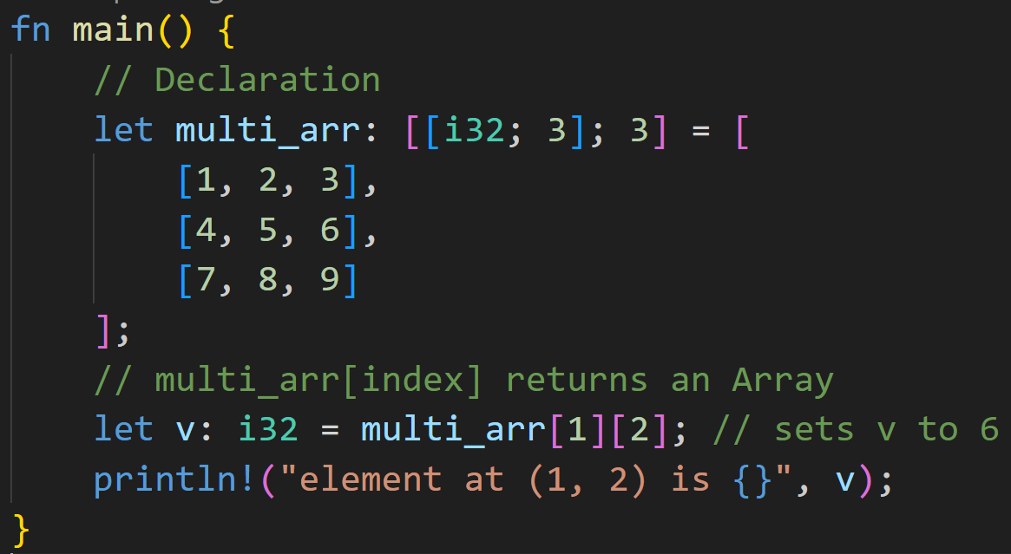
Recap
©Philippe Felix Haupt 2023

Slide 26
Recap
[4, 5, 6]
©Philippe Felix Haupt 2023

Slide 27
Recap
[4, 5, 6][2]
©Philippe Felix Haupt 2023

Slide 28
Recap
6
©Philippe Felix Haupt 2023

Slide 29
Loops
©Philippe Felix Haupt 2023

Slide 30
Loops
Writing code that fits a single Array/Vector* size is easy, but breaks once you modify its size
*Note: I will use Arrays and Vectors interchangeably today
©Philippe Felix Haupt 2023

Slide 31
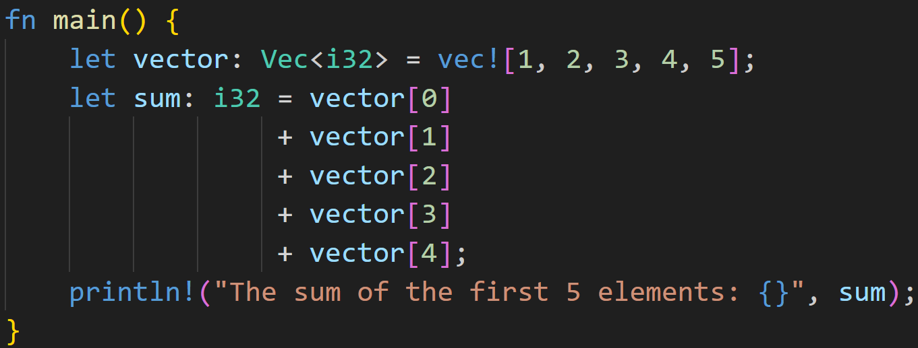
Loops
Writing code that fits a single Array/Vector* size is easy, but breaks once you modify its size
*Note: I will use Arrays and Vectors interchangeably today
©Philippe Felix Haupt 2023

Slide 32
Loops
Writing code that fits a single Array/Vector* size is easy, but breaks once you modify its size
What happens if we add a 6th element?
©Philippe Felix Haupt 2023

Slide 33
Loops
Writing code that fits a single Array/Vector* size is easy, but breaks once you modify its size
Write another line, easy!
©Philippe Felix Haupt 2023

Slide 34
Loops
Writing code that fits a single Array/Vector* size is easy, but breaks once you modify its size
Write another line, easy?
Now do it for 1000 elements! :^)
©Philippe Felix Haupt 2023

Slide 35
Loops
Writing code that fits a single Array/Vector* size is easy, but breaks once you modify its size
Sometimes you don’t know how big a Vector is, but want to do something for every element in it
©Philippe Felix Haupt 2023

Slide 36
Loops
Writing code that fits a single Array/Vector* size is easy, but breaks once you modify its size
Sometimes you don’t know how big a Vector is, but want to do something for every element in it
Sometimes you want to go over a range of numbers, and do something for every number you see
©Philippe Felix Haupt 2023

Slide 37
Loops
Writing code that fits a single Array/Vector* size is easy, but breaks once you modify its size
Sometimes you don’t know how big a Vector is, but want to do something for every element in it
Sometimes you want to go over a range of numbers, and do something for every number you see
For every number below 1000, print the primes :)
©Philippe Felix Haupt 2023

Slide 38
Loops
Writing code that fits a single Array/Vector* size is easy, but breaks once you modify its size
Sometimes you don’t know how big a Vector is, but want to do something for every element in it
Sometimes you want to go over a range of numbers, and do something for every number you see
For every number below 1000, print the primes :)
Play a game of FizzBuzz
©Philippe Felix Haupt 2023

Slide 39
Loops
Writing code that fits a single Array/Vector* size is easy, but breaks once you modify its size
Sometimes you don’t know how big a Vector is, but want to do something for every element in it
Sometimes you want to go over a range of numbers, and do something for every number you see
For every number below 1000, print the primes :)
Play a game of FizzBuzz
For every number below 100:
if divisible by 3 print “Fizz”
if divisible by 5 print “Buzz”
if divisible by 15 print “FizzBuzz”
else print the number
©Philippe Felix Haupt 2023

Slide 40
Loops
Writing code that fits a single Array/Vector* size is easy, but breaks once you modify its size
Sometimes you don’t know how big a Vector is, but want to do something for every element in it
Sometimes you want to go over a range of numbers, and do something for every number you see
For every number below 1000, print the primes :)
Play a game of FizzBuzz
For every number below 100:
if divisible by 3 print “Fizz”
if divisible by 5 print “Buzz”
if divisible by 15 print “FizzBuzz”
else print the number
©Philippe Felix Haupt 2023

Slide 41
Loops
Writing code that fits a single Array/Vector* size is easy, but breaks once you modify its size
Sometimes you don’t know how big a Vector is, but want to do something for every element in it
Sometimes you want to go over a range of numbers, and do something for every number you see
Need to do any of that? Loops are your friend!
©Philippe Felix Haupt 2023

Slide 42
Loops
A Loop does exactly what you think it does, it loops a piece of code
©Philippe Felix Haupt 2023

Slide 43
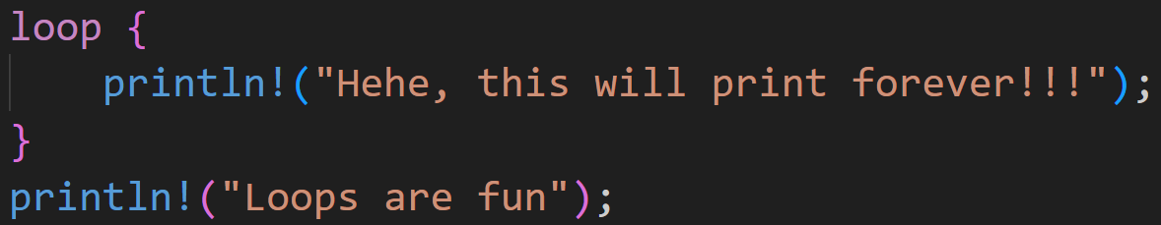
Loops
A Loop does exactly what you think it does, it loops a piece of code
©Philippe Felix Haupt 2023

Slide 44
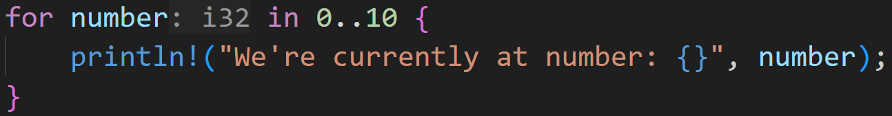
Loops
A Loop does exactly what you think it does, it loops a piece of code
©Philippe Felix Haupt 2023

Slide 45
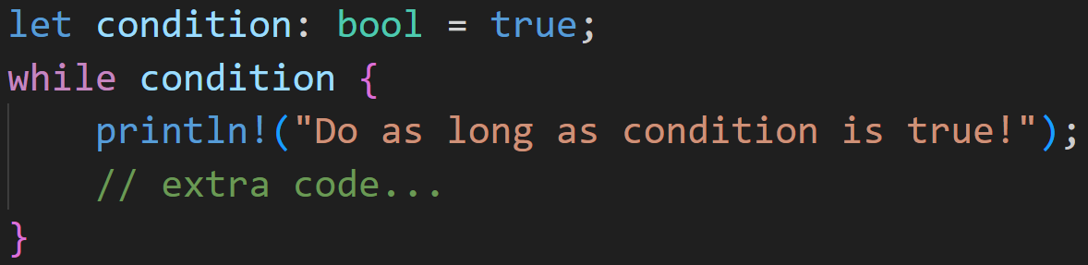
Loops
A Loop does exactly what you think it does, it loops a piece of code
©Philippe Felix Haupt 2023

Slide 46
Loops
A Loop does exactly what you think it does, it loops a piece of code
0/3
Will this loop ever stop?
©Philippe Felix Haupt 2023

Slide 47
Loops
A Loop does exactly what you think it does, it loops a piece of code
0/3
Immutable, will always be true
→ condition will never be false
→ Loop will never stop on its own
Will this loop ever stop?
©Philippe Felix Haupt 2023

Slide 48
Loops
A Loop does exactly what you think it does, it loops a piece of code
Many types of loops:
loop
while
for
©Philippe Felix Haupt 2023

Slide 49
Loops
A Loop does exactly what you think it does, it loops a piece of code
Many types of loops:
loop
while
for
Each type has their own use cases
©Philippe Felix Haupt 2023

Slide 50
Loops
A Loop does exactly what you think it does, it loops a piece of code
Many types of loops:
loop
while
for
Each type has their own use cases
`loop` if you know that your loop never stops
©Philippe Felix Haupt 2023

Slide 51
Loops
A Loop does exactly what you think it does, it loops a piece of code
Many types of loops:
loop
while
for
Each type has their own use cases
`loop` if you know that your loop never stops
A server will never stop listening to requests
©Philippe Felix Haupt 2023

Slide 52
Loops
A Loop does exactly what you think it does, it loops a piece of code
Many types of loops:
loop
while
for
Each type has their own use cases
`loop` if you know that your loop never stops
`while` if you want to loop based on a condition
©Philippe Felix Haupt 2023

Slide 53
Loops
A Loop does exactly what you think it does, it loops a piece of code
Many types of loops:
loop
while
for
Each type has their own use cases
`loop` if you know that your loop never stops
`while` if you want to loop based on a condition
While there are elements in this set, do X
©Philippe Felix Haupt 2023

Slide 54
Loops
A Loop does exactly what you think it does, it loops a piece of code
Many types of loops:
loop
while
for
Each type has their own use cases
`loop` if you know that your loop never stops
`while` if you want to loop based on a condition
`for` if you want to iterate* over a collection
©Philippe Felix Haupt 2023

Slide 55
Loops
A Loop does exactly what you think it does, it loops a piece of code
Many types of loops:
loop
while
for
Each type has their own use cases
`loop` if you know that your loop never stops
`while` if you want to loop based on a condition
`for` if you want to iterate* over a collection
For every number in a range
For every element in a Vector
For every dog in my local park
©Philippe Felix Haupt 2023

Slide 56
Loops - loop
`loop` is the simplest form of loops in Rust
©Philippe Felix Haupt 2023

Slide 57
Loops - loop
`loop` is the simplest form of loops in Rust
It’s also pretty dumb, it can not stop, ever*
©Philippe Felix Haupt 2023

Slide 58
Loops - loop
`loop` is the simplest form of loops in Rust
It’s also pretty dumb, it can not stop, ever*
Example use cases:
©Philippe Felix Haupt 2023

Slide 59
Loops - loop
`loop` is the simplest form of loops in Rust
It’s also pretty dumb, it can not stop, ever*
Example use cases:
You don’t want your code to ever stop
Servers listen to requests 24/7
©Philippe Felix Haupt 2023

Slide 60
Loops - loop
`loop` is the simplest form of loops in Rust
It’s also pretty dumb, it can not stop, ever*
Example use cases:
You don’t want your code to ever stop
Your `while`-condition would be too complex to put in one expression
Instead, split into sub-expressions and test each of them separately
More on that later
©Philippe Felix Haupt 2023

Slide 61
Loops - loop
`loop` is the simplest form of loops in Rust
It’s also pretty dumb, it can not stop, ever*
Example use cases:
You don’t want your code to ever stop
Your `while`-condition would be too complex to put in one expression
Stress Testing your CPU (simplest way of getting 100% usage)
©Philippe Felix Haupt 2023

Slide 62
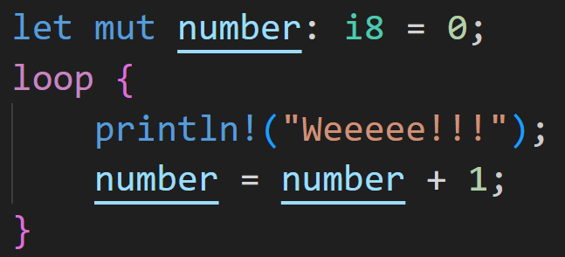
Loops - loop
a `loop` loop may look like this:
©Philippe Felix Haupt 2023

Slide 63
Loops - loop
a `loop` loop may look like this:
body of the loop
©Philippe Felix Haupt 2023

Slide 64
Loops - loop
a `loop` loop may look like this:
print Weeeee!!!
increase number
©Philippe Felix Haupt 2023

Slide 65
Loops - loop
a `loop` loop may look like this:
uses this variable
©Philippe Felix Haupt 2023

Slide 66
Loops - loop
a `loop` loop may look like this:
Program crashes once number is too big
©Philippe Felix Haupt 2023

Slide 67
Intermission: Scopes
Statements wrapped in curly brackets are called code blocks
©Philippe Felix Haupt 2023

Slide 68
Intermission: Scopes
Statements wrapped in curly brackets are called code blocks
Each Block has a scope in which it operates
©Philippe Felix Haupt 2023

Slide 69
Intermission: Scopes
Statements wrapped in curly brackets are called code blocks
Each Block has a scope in which it operates
Blocks can access variables from outer scopes
©Philippe Felix Haupt 2023

Slide 70
Intermission: Scopes
Statements wrapped in curly brackets are called code blocks
Each Block has a scope in which it operates
Blocks can access variables from outer scopes
Variables can only be used in scopes they’re defined in
©Philippe Felix Haupt 2023

Slide 71
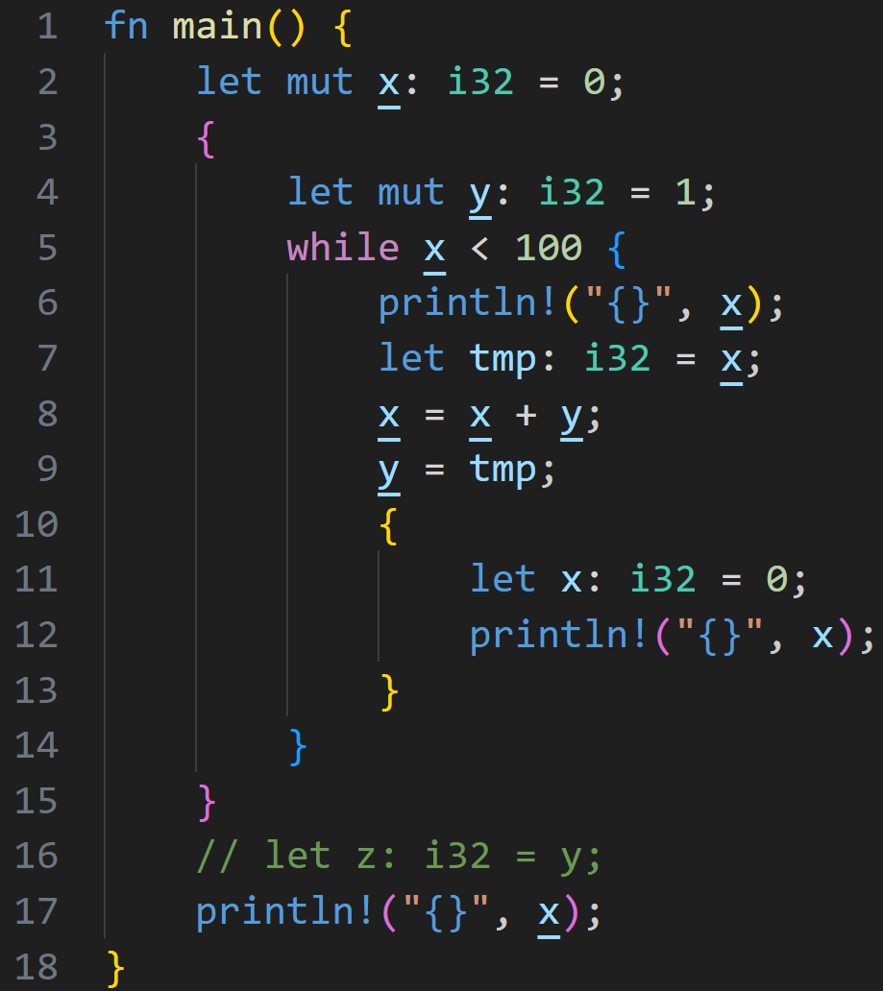
Intermission: Scopes
©Philippe Felix Haupt 2023

Slide 72
Intermission: Scopes
main scope
©Philippe Felix Haupt 2023

Slide 73
Intermission: Scopes
Scope | Start | End | Variables
©Philippe Felix Haupt 2023

Slide 74
Intermission: Scopes
Scope | Start | End | Variables
main | 1
©Philippe Felix Haupt 2023

Slide 75
Intermission: Scopes
Scope | Start | End | Variables
main | 1 |  | x
©Philippe Felix Haupt 2023

Slide 76
Intermission: Scopes
Scope | Start | End | Variables
main | 1 |  | x
1 | 3
©Philippe Felix Haupt 2023

Slide 77
Intermission: Scopes
Scope | Start | End | Variables
main | 1 |  | x
1 | 3 |  | y
©Philippe Felix Haupt 2023

Slide 78
Intermission: Scopes
Scope | Start | End | Variables
main | 1 |  | x
1 | 3 |  | y
No `x` in current scope, check previous scopes!
©Philippe Felix Haupt 2023

Slide 79
Intermission: Scopes
Scope | Start | End | Variables
main | 1 |  | x
1 | 3 |  | y
Uses the `x` from the main scope
©Philippe Felix Haupt 2023

Slide 80
Intermission: Scopes
Scope | Start | End | Variables
main | 1 |  | x
1 | 3 |  | y
2 | 5
©Philippe Felix Haupt 2023

Slide 81
Intermission: Scopes
Scope | Start | End | Variables
main | 1 |  | x
1 | 3 |  | y
2 | 5
Uses the `x` from the main scope
©Philippe Felix Haupt 2023

Slide 82
Intermission: Scopes
Scope | Start | End | Variables
main | 1 |  | x
1 | 3 |  | y
2 | 5 |  | tmp
Uses the `x` from the main scope
©Philippe Felix Haupt 2023

Slide 83
Intermission: Scopes
Scope | Start | End | Variables
main | 1 |  | x
1 | 3 |  | y
2 | 5 |  | tmp
©Philippe Felix Haupt 2023

Slide 84
Intermission: Scopes
Scope | Start | End | Variables
main | 1 |  | x
1 | 3 |  | y
2 | 5 |  | tmp
This also updates the main scope `x`!
©Philippe Felix Haupt 2023

Slide 85
Intermission: Scopes
Scope | Start | End | Variables
main | 1 |  | x
1 | 3 |  | y
2 | 5 |  | tmp
Updates this `y`
©Philippe Felix Haupt 2023

Slide 86
Intermission: Scopes
Scope | Start | End | Variables
main | 1 |  | x
1 | 3 |  | y
2 | 5 |  | tmp
3 | 10
©Philippe Felix Haupt 2023

Slide 87
Intermission: Scopes
Scope | Start | End | Variables
main | 1 |  | x
1 | 3 |  | y
2 | 5 |  | tmp
3 | 10 |  | x
©Philippe Felix Haupt 2023

Slide 88
Intermission: Scopes
Scope | Start | End | Variables
main | 1 |  | x
1 | 3 |  | y
2 | 5 |  | tmp
3 | 10 |  | x
`x` defined in current scope, uses this one!
©Philippe Felix Haupt 2023

Slide 89
Intermission: Scopes
Scope | Start | End | Variables
main | 1 |  | x
1 | 3 |  | y
2 | 5 |  | tmp
3 | 10 | 13 | x
©Philippe Felix Haupt 2023

Slide 90
Intermission: Scopes
Scope | Start | End | Variables
main | 1 |  | x
1 | 3 |  | y
2 | 5 | 14 | tmp
3 | 10 | 13 | x
©Philippe Felix Haupt 2023

Slide 91
Intermission: Scopes
Scope | Start | End | Variables
main | 1 |  | x
1 | 3 | 15 | y
2 | 5 | 14 | tmp
3 | 10 | 13 | x
©Philippe Felix Haupt 2023

Slide 92
Intermission: Scopes
Scope | Start | End | Variables
main | 1 |  | x
1 | 3 | 15 | y
2 | 5 | 14 | tmp
3 | 10 | 13 | x
Would throw a compile-time error, there is no `y` in the current or previous scopes!
©Philippe Felix Haupt 2023

Slide 93
Intermission: Scopes
Scope | Start | End | Variables
main | 1 |  | x
1 | 3 | 15 | y
2 | 5 | 14 | tmp
3 | 10 | 13 | x
this `y` is no longer valid, it expired in line 15, with the end of scope 1
©Philippe Felix Haupt 2023

Slide 94
Intermission: Scopes
Scope | Start | End | Variables
main | 1 |  | x
1 | 3 | 15 | y
2 | 5 | 14 | tmp
3 | 10 | 13 | x
This scope isn’t even a previous scope of main!
©Philippe Felix Haupt 2023

Slide 95
Intermission: Scopes
Scope | Start | End | Variables
main | 1 |  | x
1 | 3 | 15 | y
2 | 5 | 14 | tmp
3 | 10 | 13 | x
prints 144
©Philippe Felix Haupt 2023

Slide 96
Intermission: Scopes
Scope | Start | End | Variables
main | 1 | 18 | x
1 | 3 | 15 | y
2 | 5 | 14 | tmp
3 | 10 | 13 | x
©Philippe Felix Haupt 2023

Slide 97
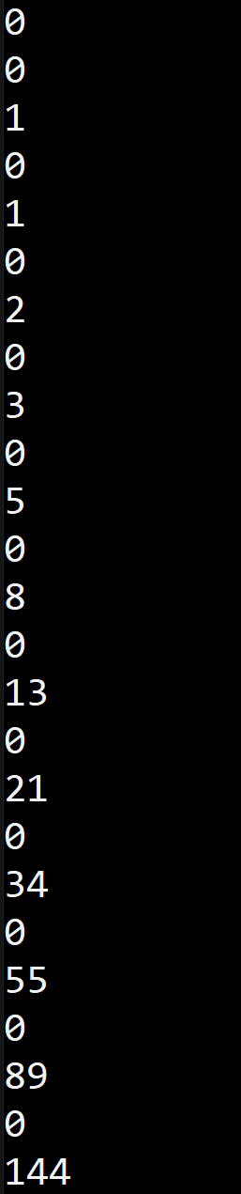
Intermission: Scopes
Output:
©Philippe Felix Haupt 2023

Slide 98
Loops - while
`while` is the advanced version of `loop`
©Philippe Felix Haupt 2023

Slide 99
Loops - while
`while` is the advanced version of `loop`
whereas `loop` loops forever, `while` stops once a condition is no longer satisfied
©Philippe Felix Haupt 2023

Slide 100
Loops - while
`while` is the advanced version of `loop`
whereas `loop` loops forever, `while` stops once a condition is no longer satisfied
Conditions are expressions which return a boolean (true or false):
©Philippe Felix Haupt 2023

Slide 101
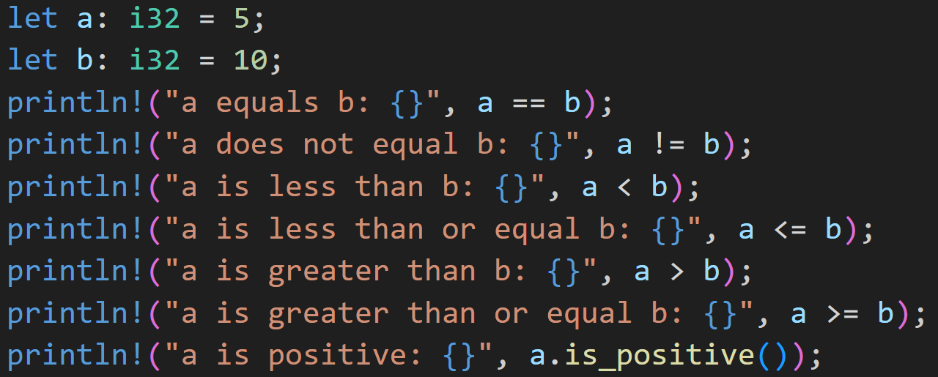
Loops - while
`while` is the advanced version of `loop`
whereas `loop` loops forever, `while` stops once a condition is no longer satisfied
Conditions are expressions which return a boolean (true or false):
©Philippe Felix Haupt 2023

Slide 102
Loops - while
`while` is the advanced version of `loop`
whereas `loop` loops forever, `while` stops once a condition is no longer satisfied
Conditions are expressions which return a boolean (true or false):
0/3
What are the results of each line?
©Philippe Felix Haupt 2023

Slide 103
Loops - while
`while` is the advanced version of `loop`
whereas `loop` loops forever, `while` stops once a condition is no longer satisfied
Conditions are expressions which return a boolean (true or false):
0/3
What are the results of each line?
false
true
true
true
false
false
true
©Philippe Felix Haupt 2023

Slide 104
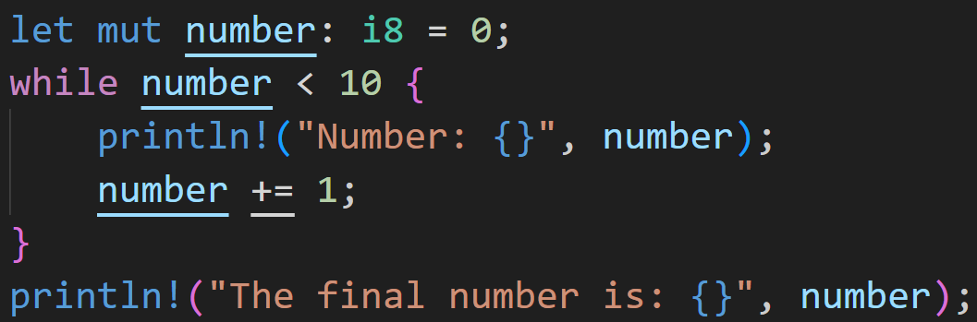
Loops - while
a `while` loop may look like this:
©Philippe Felix Haupt 2023

Slide 105
Loops - while
a `while` loop may look like this:
while number is less than 10, do the things in the code block
©Philippe Felix Haupt 2023

Slide 106
Loops - while
Note: Unlike other languages, there are no brackets around the condition!
a `while` loop may look like this:
©Philippe Felix Haupt 2023

Slide 107
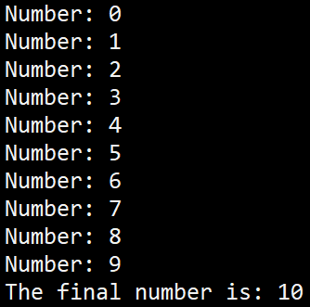
Loops - while
a `while` loop may look like this:
©Philippe Felix Haupt 2023

Slide 108
Loops - while
last step: 10 is not less than 10, so it does not enter the loop again
a `while` loop may look like this:
©Philippe Felix Haupt 2023

Slide 109
Loops - for
`for` is a very powerful loop
It allows you to comfortably loop over data collections
©Philippe Felix Haupt 2023

Slide 110
Loops - for
`for` is a very powerful loop
It allows you to comfortably loop over data collections
Wherever power is involved, rules are necessary:
©Philippe Felix Haupt 2023

Slide 111
Loops - for
`for` is a very powerful loop
It allows you to comfortably loop over data collections
Wherever power is involved, rules are necessary:
To be able to use `for` on a collection, it needs to implement an iterator-trait
©Philippe Felix Haupt 2023

Slide 112
Loops - for
`for` is a very powerful loop
It allows you to comfortably loop over data collections
Wherever power is involved, rules are necessary:
To be able to use `for` on a collection, it needs to implement an iterator-trait
Needs a function to get the next element
Needs a condition where it stops (no more elements)
©Philippe Felix Haupt 2023

Slide 113
Loops - for
`for` is a very powerful loop
It allows you to comfortably loop over data collections
Wherever power is involved, rules are necessary:
To be able to use `for` on a collection, it needs to implement an iterator-trait
`for` usually implicitly turns your collections into iterators
©Philippe Felix Haupt 2023

Slide 114
Loops - for
`for` is a very powerful loop
It allows you to comfortably loop over data collections
Wherever power is involved, rules are necessary:
To be able to use `for` on a collection, it needs to implement an iterator-trait
`for` usually implicitly turns your collections into iterators
If you’re not using a reference, it moves the collection and you can’t use it anymore
©Philippe Felix Haupt 2023

Slide 115
Loops - for
`for` is a very powerful loop
It allows you to comfortably loop over data collections
Wherever power is involved, rules are necessary:
To be able to use `for` on a collection, it needs to implement an iterator-trait
`for` usually implicitly turns your collections into iterators
If you’re not using a reference, it moves the collection and you can’t use it anymore
References will be covered next week when we introduce the Ownership Model, for now most examples only work as isolated blocks :^)
©Philippe Felix Haupt 2023

Slide 116
Loops - for
`for` is a very powerful loop
It allows you to comfortably loop over data collections
Wherever power is involved, rules are necessary:
To be able to use `for` on a collection, it needs to implement an iterator-trait
`for` usually implicitly turns your collections into iterators
If you’re not using a reference, it moves the collection and you can’t use it anymore
References will be covered next week when we introduce the Ownership Model, for now most examples only work as isolated blocks :^)
If you feel very brave, you can try and slap & in front of vectors when you use them in a `for` loop, and see what happens
©Philippe Felix Haupt 2023

Slide 117
Loops - for
`for` is a very powerful loop
It allows you to comfortably loop over data collections
Wherever power is involved, rules are necessary:
To be able to use `for` on a collection, it needs to implement an iterator-trait
`for` usually implicitly turns your collections into iterators
If you’re not using a reference, it moves the collection and you can’t use it anymore
References will be covered next week when we introduce the Ownership Model, for now most examples only work as isolated blocks :^)
If you feel very brave, you can try and slap & in front of vectors when you use them in a `for` loop, and see what happens
Iterators are scary and complex, we’ll ignore most of it as long as possible and still have fun with our non-idiomatic code :)
©Philippe Felix Haupt 2023

Slide 118
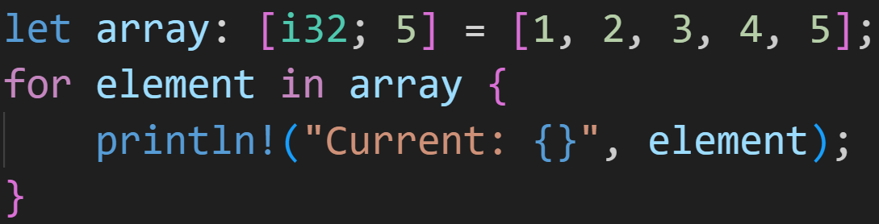
Loops - for
a `for` loop may look like this:
©Philippe Felix Haupt 2023

Slide 119
Loops - for
a `for` loop may look like this:
This syntax is very readable:
For every element in the array, do X
©Philippe Felix Haupt 2023

Slide 120
Loops - for
a `for` loop may look like this:
Instead of using indices, in the loop you’re always working with the current element, in this case called `element`
©Philippe Felix Haupt 2023

Slide 121
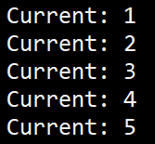
Loops - for
Output:
a `for` loop may look like this:
©Philippe Felix Haupt 2023

Slide 122
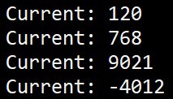
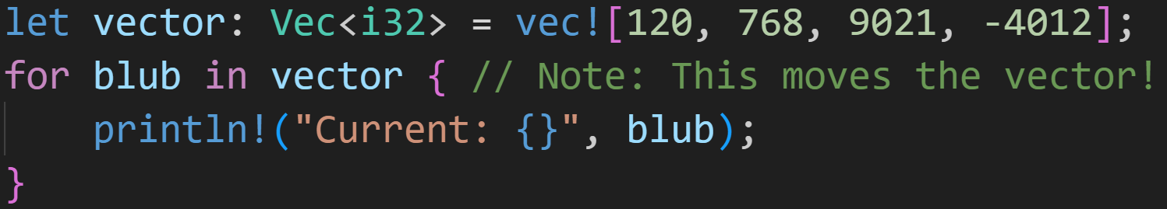
Loops - for
Output:
a `for` loop may look like this:
©Philippe Felix Haupt 2023

Slide 123
Loops - for
Output:
a `for` loop may look like this:
You can name this whatever you want
©Philippe Felix Haupt 2023

Slide 124
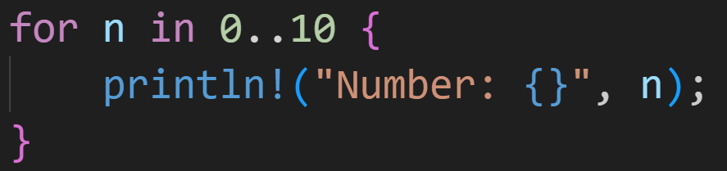
Loops - for
a `for` loop may look like this:
©Philippe Felix Haupt 2023

Slide 125
Loops - for
Rust’s range operator: Creates a range of values
Here: Creates a range of whole numbers between 0 and 10
a `for` loop may look like this:
©Philippe Felix Haupt 2023

Slide 126
Loops - for
Rust’s range operator: Creates a range of values
Here: Creates a range of whole numbers between 0 and 10
a `for` loop may look like this:
`n` will take on the values 0, 1, 2, 3, 4, 5, 6, 7, 8, 9
©Philippe Felix Haupt 2023

Slide 127
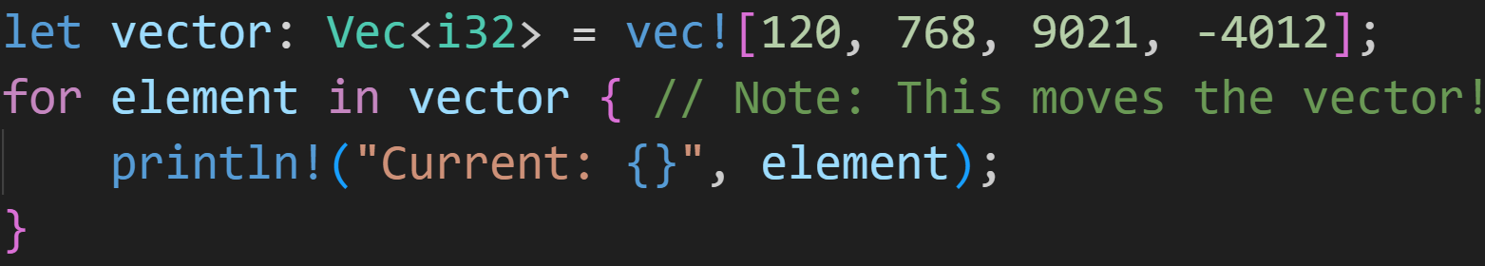
Loops - Extra
Converting from an iterator-based `for` loop to a normal `loop`:
©Philippe Felix Haupt 2023

Slide 128
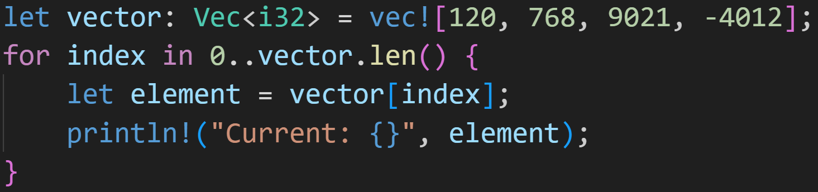
Loops - Extra
Converting from an iterator-based `for` loop to a normal `loop`:
©Philippe Felix Haupt 2023

Slide 129
Loops - Extra
Converting from an iterator-based `for` loop to a normal `loop`:
Generate all indices of your vector
Normal index access now
©Philippe Felix Haupt 2023

Slide 130
Loops - Extra
Converting from an iterator-based `for` loop to a normal `loop`:
Still using `for`, we need to go deeper!
©Philippe Felix Haupt 2023

Slide 131
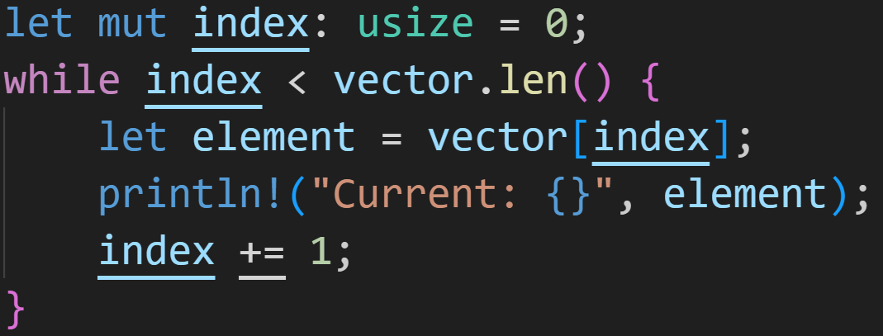
Loops - Extra
Converting from an iterator-based `for` loop to a normal `loop`:
©Philippe Felix Haupt 2023

Slide 132
Loops - Extra
Converting from an iterator-based `for` loop to a normal `loop`:
Range is still there
©Philippe Felix Haupt 2023

Slide 133
Loops - Extra
Converting from an iterator-based `for` loop to a normal `loop`:
Range is still there
Also need to manage the ‘Get Next’ step of an iterator
©Philippe Felix Haupt 2023

Slide 134
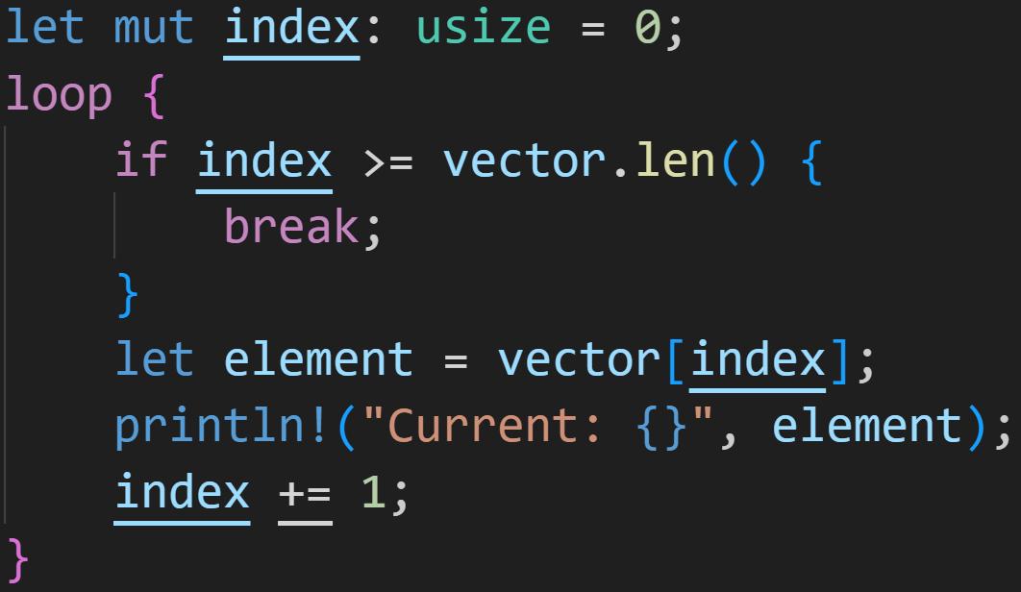
Loops - Extra
Converting from an iterator-based `for` loop to a normal `loop`:
©Philippe Felix Haupt 2023

Slide 135
Loops - Extra
Converting from an iterator-based `for` loop to a normal `loop`:
In a `while` we want to loop while condition is `true`, so we want to break out of the loop when condition is `false`
not (a < b) ⇒ a >= b
©Philippe Felix Haupt 2023

Slide 136
Loops - Extra
Converting from an iterator-based `for` loop to a normal `loop`:
In a `while` we want to loop while condition is `true`, so we want to break out of the loop when condition is `false`
not (a < b) ⇒ a >= b
Special keyword to break out of any loop, while or for
→ Program continues execution after loop-body, in this case after the pink brackets
©Philippe Felix Haupt 2023

Slide 137
Loops - Extra
Converting from an iterator-based `for` loop to a normal `loop`:
Still access as usual
©Philippe Felix Haupt 2023

Slide 138
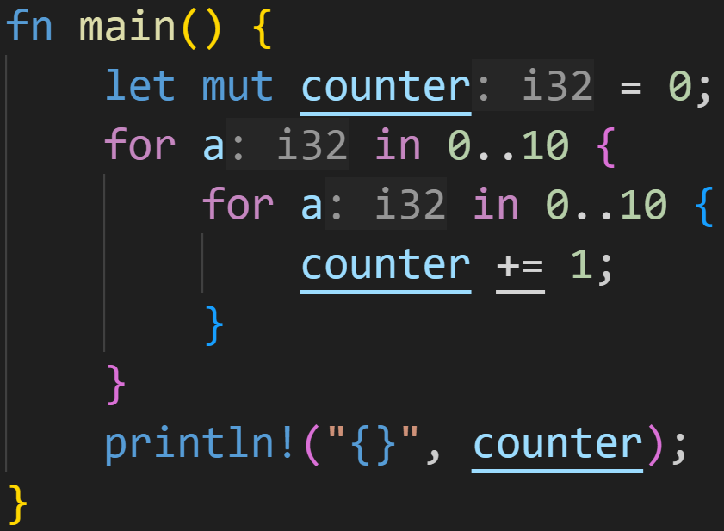
Intermission: Exercise
Time for a big exercise today!
2/3
©Philippe Felix Haupt 2023

Slide 139
Intermission: Exercise
Time for a big exercise today!
What’s the value of `counter` after the 2 loops?
2/3
©Philippe Felix Haupt 2023

Slide 140
Intermission: Exercise
Time for a big exercise today!
What’s the value of `counter` after the 2 loops?
2/3
Answer: 100
©Philippe Felix Haupt 2023

Slide 141
Intermission: Exercise
Time for a big exercise today!
What’s the value of `counter` after the 2 loops?
2/3
Answer: 100
- When nesting loops, you’re multiplying their loop-counts together:
©Philippe Felix Haupt 2023

Slide 142
Intermission: Exercise
Time for a big exercise today!
What’s the value of `counter` after the 2 loops?
2/3
Answer: 100
- When nesting loops, you’re multiplying their loop-counts together:
- For every outer loop you need to run the inner loop 10 times
©Philippe Felix Haupt 2023

Slide 143
Intermission: Exercise
Time for a big exercise today!
What’s the value of `counter` after the 2 loops?
2/3
Answer: 100
- When nesting loops, you’re multiplying their loop-counts together:
- For every outer loop you need to run the inner loop 10 times
- Running the outer loop 10 times:
10x10 = 100 iterations
©Philippe Felix Haupt 2023

Slide 144
Intermission: Exercise
Time for a big exercise today!
What’s the value of `counter` after the 2 loops?
2/3
Index is not linked to variable name, shadowing did not matter
©Philippe Felix Haupt 2023

Slide 145
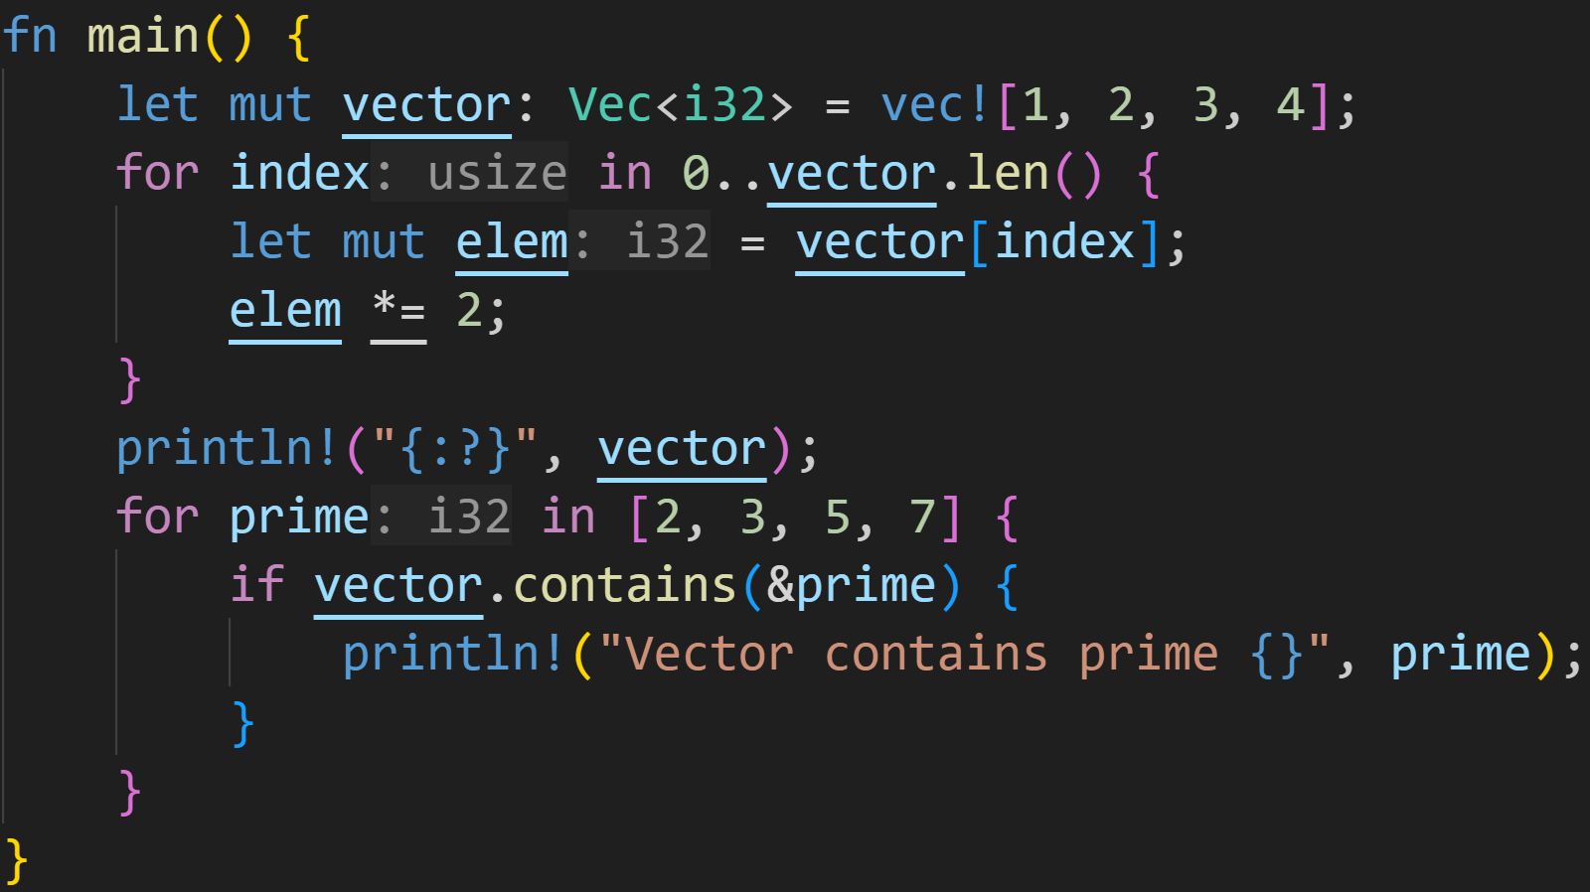
Intermission: Exercise
Time for a big exercise today!
2/3
©Philippe Felix Haupt 2023

Slide 146
Intermission: Exercise
Time for a big exercise today!
2/3
What does the vector look like in the middle?
What primes does it contain?
©Philippe Felix Haupt 2023

Slide 147
Intermission: Exercise
Time for a big exercise today!
2/3
We’re never actually setting elements in the vector! We’re only assigning to a local variable.
©Philippe Felix Haupt 2023

Slide 148
Intermission: Exercise
Time for a big exercise today!
2/3
prints [1, 2, 3, 4]
©Philippe Felix Haupt 2023

Slide 149
Intermission: Exercise
Time for a big exercise today!
2/3
vector contains 2 and 3, so it prints those two
©Philippe Felix Haupt 2023

Slide 150
Next time
Working on the same elements instead of copying them:
References
Ownership
Copy vs Move vs Ref
Borrow Checking
©Philippe Felix Haupt 2023

